Slide 1




Measuring short-term effects of air pollution (BAPHE)
Soutrik Banerjee
27-06-2013
E
P
A
R

Slide 2


Background (1)
BAPHE stands for Beirut Air Pollution Health Effects study
Data were collected from 1st January to 31st December, 2012 (366 days)
Data on daily hospital admissions were collected from ~75% hospitals (records) in Beirut
The principal diagnosis for each case was extracted using the International Classification of Diseases, 9th revision (ICD-9), coding system
E
P
A
R

Slide 3
Background (2)
From the ICD codes, the diagnoses were grouped into 5 groups and all-cause admission
The 5 groups were: cerebro-vascular accident (CVA), ischaemic heart disease (IHD), respiratory causes, hives (urticaria and allergy), ear problems
The age and gender were also noted for carrying out stratified analysis by age-group and gender
E
P
A
R

Slide 4
Background (3)
Data on air pollution were obtained from the air-quality monitoring station(s), which recorded hourly air pollution levels
The pollutants recorded were airborne Particulate Matters of weight ≤ 10 µg and ≤ 2.5 µg (PM₁₀ and PM_{2.5}, respectively)
A daily average was computed for PM_{2.5} and PM₁₀ (and, so forth for SO₂, NO₂, NO_{x}, ...)
E
P
A
R

Slide 5
Background (4)
For Ozone (O₃), one can adopt either of the 2 strategies:
Compute a daily average (like other pollutants)
Take the maximum of the 8-hour moving average during the day
Sometimes Ozone is measured only during the summer seasons in certain cities
E
P
A
R

Slide 6
Background (5)
Additional meteorological/other data needed for analyses were, which can also affect/‘confound’ the outcomes:
Daily temperature (°C)
Daily relative humidity (%)
Day of the week (weekday/weekend-holiday)
Other meteorological factors are not usually used for analyses: atmospheric pressure, wind speed, dew point, ...
E
P
A
R

Slide 7
Goal
Study the short-term risks of different outcomes for different pollutants
Determine the lag period (days), when the association between the pollutant and outcome becomes statistically significant, and also when does this association peak
To determine the % increase in morbidity per 10-unit increase in the pollutant concentration
E
P
A
R

Slide 8
Data: excerpt
date | cva | ihd | resp | hives | ear | PM₁₀ | PM_{2.5} | dow | temp | rh
10/01/2012 | 0 | 16 | 26 | 0 | 0 | 37.92 | 23.16 | 1 | 14.13 | 42.42
11/01/2012 | 0 | 5 | 18 | 1 | 0 | 46.71 | 19.25 | 1 | 11.67 | 39.79
12/01/2012 | 0 | 9 | 23 | 0 | 0 | 35.13 | 25.33 | 1 | 9 | 39.79
13/01/2012 | 0 | 11 | 22 | 0 | 2 | 28.88 | 18.38 | 1 | 9.5 | 36.5
14/01/2012 | 2 | 7 | 16 | 0 | 0 | 49.29 | 26.38 | 0 | 11.21 | 39.25
15/01/2012 | 0 | 9 | 24 | 0 | 0 | 22.33 | 18.42 | 0 | 12.79 | 42.92
16/01/2012 | 0 | 15 | 27 | 0 | 0 | 40.63 | 28.46 | 1 | 12.58 | 41.67
E
P
A
R

Slide 9
Methods
Time series analysis was used to study the short-term impact of PM on the 5 outcomes
Model: Distributed Lag Model (DLM) was used to estimate the % increase in the admission as well as the day when the association peaked between the PM and a given outcome (0-13 day lags were considered)
Approach: Generalised Linear Models (GLM) and Generalised Additive Models (GAM) frameworks with different types of splines (natural, penalised) and degrees of freedom (2-6)* were used to fit the data
Temperature, relative humidity and day of the week were used to adjust for bias due to confounders
E
P
A
R
Notes:
* The results are shown using d.f. = 5.

Slide 10
Results: summary
Outcome N.days Mean SD
CVA 366 0.5 0.9
IHD 366 11.0 4.2
Respiratory 366 18.7 6.8
Hives 366 1.1 1.2
Ear 366 0.1 0.4
Variable N.days Mean SD
PM₁₀ (µg/m³) 366 50.5 32.1
PM_{2.5} (µg/m³) 366 30.0 18.8
Temperature 366 19.7 5.6
Rel.humidity 366 52.1 8.5
E
P
A
R

Slide 11
Time-series plot of PM
E
P
A
R

Slide 12
Time-series plot of IHD and respiratory admissions
E
P
A
R

Slide 13
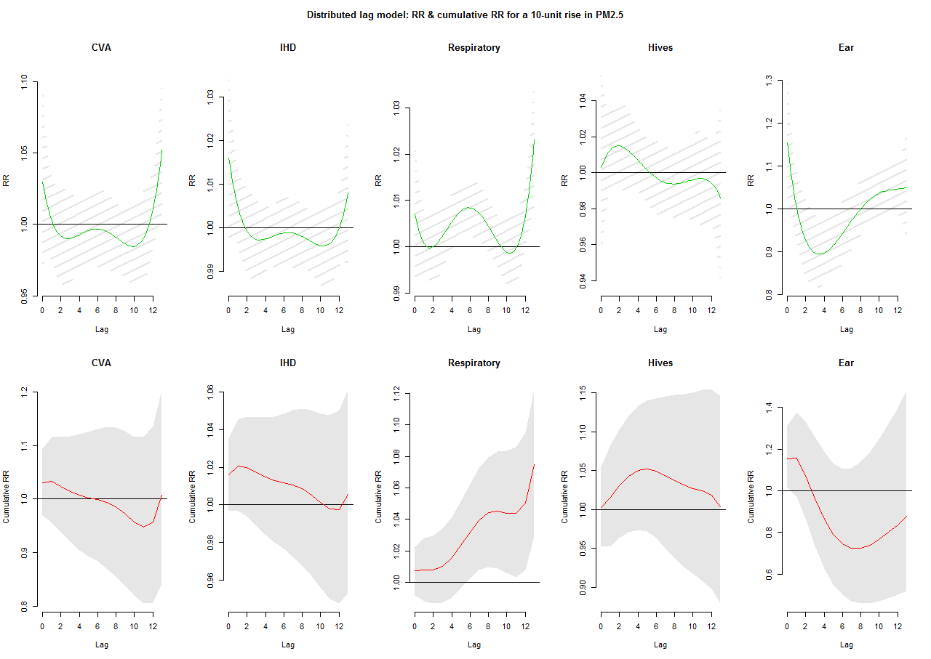
Distributed Lag Model: PM_{2.5}
E
P
A
R

Slide 14
Risk ratios (RR) between respiratory admissions and PM_{2.5}
RR 95LL 95UL
lag0 1.0070786 0.9918046 1.022588
lag1 1.0006928 0.9936722 1.007763
lag2 1.0000203 0.9924840 1.007614
lag3 1.0022828 0.9952324 1.009383
lag4 1.0053498 0.9995692 1.011164
lag5 1.0076985 1.0021310 1.013297
lag6 1.0084188 1.0022910 1.014584
lag7 1.0072274 1.0010711 1.013421
lag8 1.0044747 0.9988709 1.010110
lag9 1.0011362 0.9954007 1.006905
lag10 0.9987962 0.9917905 1.005851
lag11 0.9996460 0.9919905 1.007361
lag12 1.0065295 0.9995510 1.013557
lag13 1.0230857 1.0090347 1.037332
The % increase in respiratory hospital admission due to 10 µg/m³ increase in PM_{2.5} = 0.84% on lag6 day
E
P
A
R

Slide 15
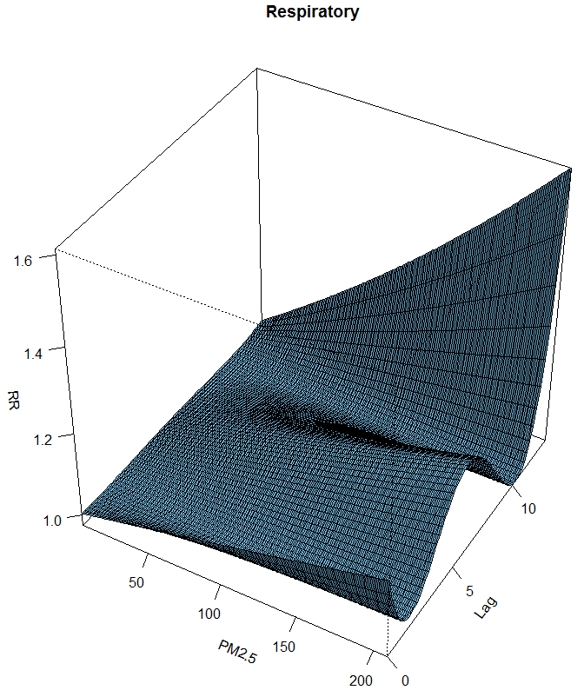
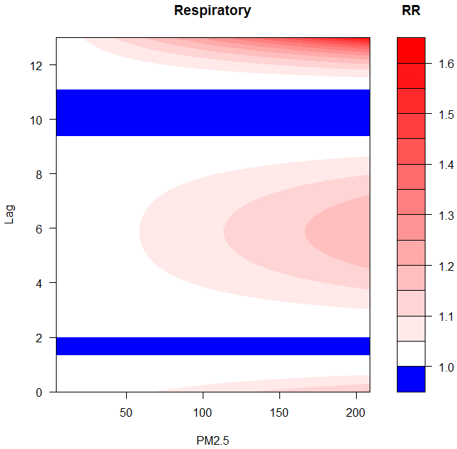
3-D and contour plots to visualise the association
E
P
A
R

Slide 16
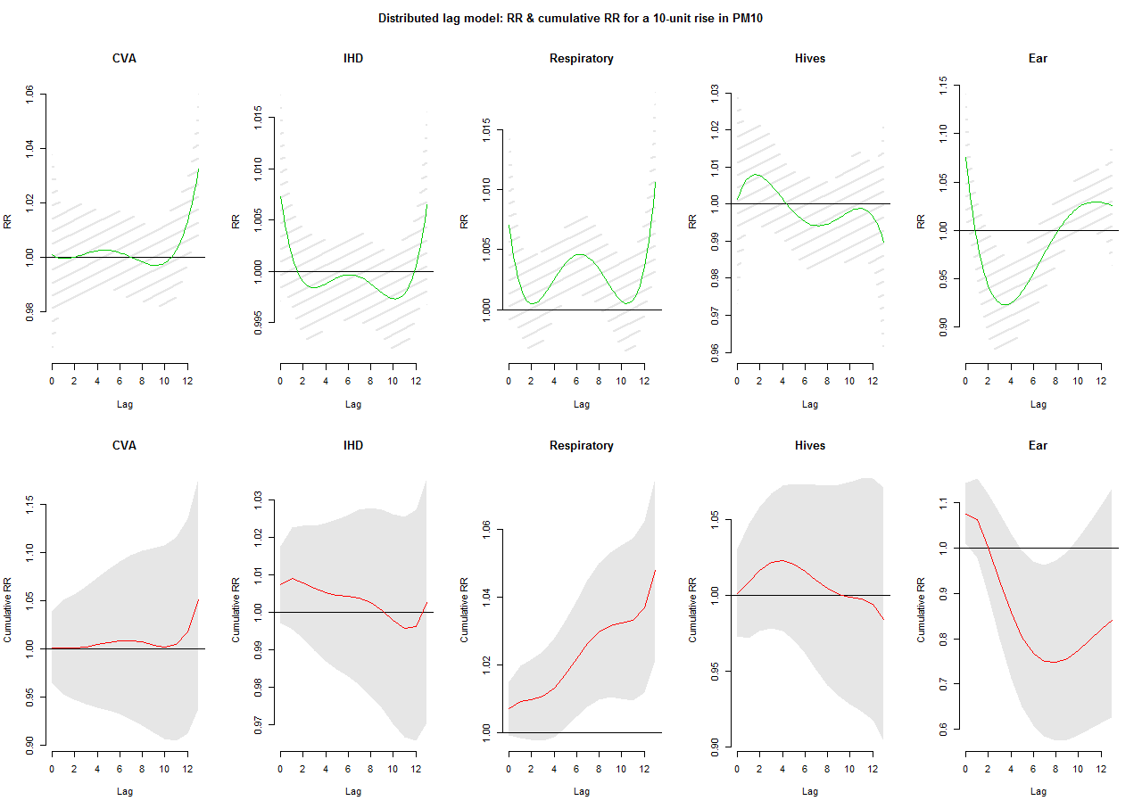
Distributed Lag Model: PM₁₀
E
P
A
R

Slide 17
Risk ratios (RR) between respiratory admissions and PM₁₀
RR 95LL 95UL
lag0 1.007045 0.9990925 1.015061
lag1 1.001969 0.9980980 1.005855
lag2 1.000497 0.9964691 1.004541
lag3 1.001076 0.9972698 1.004896
lag4 1.002491 0.9992456 1.005747
lag5 1.003847 1.0007064 1.006997
lag6 1.004565 1.0011973 1.007944
lag7 1.004387 1.0010041 1.007782
lag8 1.003377 1.0001966 1.006568
lag9 1.001922 0.9986203 1.005234
lag10 1.000726 0.9968304 1.004637
lag11 1.000811 0.9966252 1.005014
lag12 1.003523 0.9995442 1.007518
lag13 1.010562 1.0029672 1.018214
The % increase in respiratory hospital admission due to 10 µg/m³ increase in PM₁₀ = 0.46% on lag6 day
E
P
A
R

Slide 18

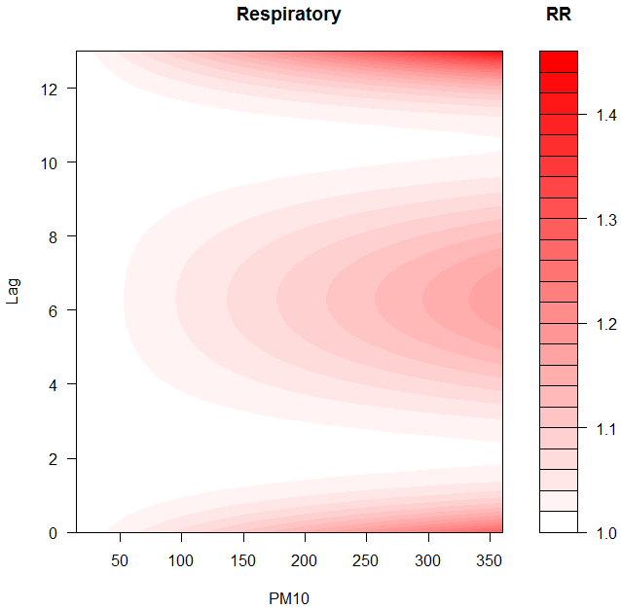
3-D and contour plots to visualise the association
E
P
A
R

Slide 19
Conclusions
Of the 5 outcomes studied, respiratory hospital admissions on the lag6 day were significantly associated (‘peaked’) with a rise of PM, 0.84% and 0.46% increase for a 10 µg/m³ rise in PM_{2.5} and PM₁₀, respectively*
Further analysis would be carried out on all-cause admissions, for other pollutants, and a stratified analysis by age-group (and gender)
E
P
A
R
Notes:
* Overall was 0.72% and 0.47% increase, respectively.

Slide 20
Thank you !
E
P
A
R

